Slide 1
Shroud.com 4.4 x 1.1m
Notes:
https://www.shroud.com/menu.htm

Slide 2
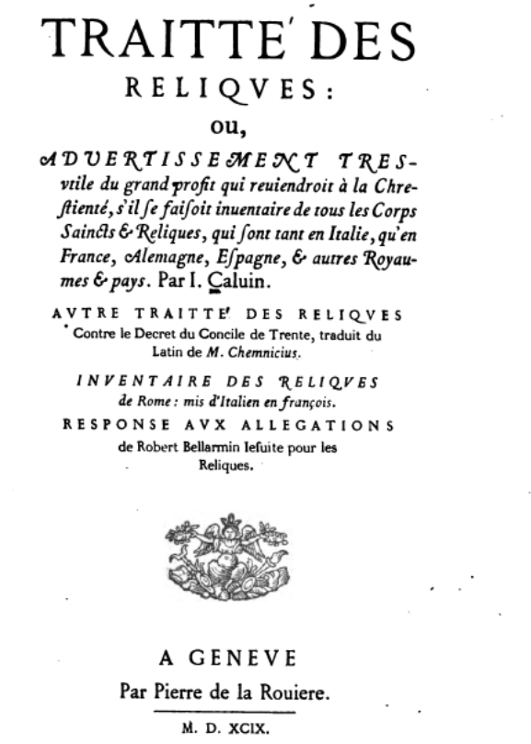
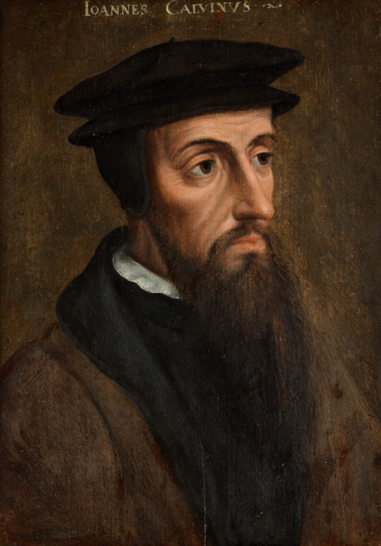

Slide 3
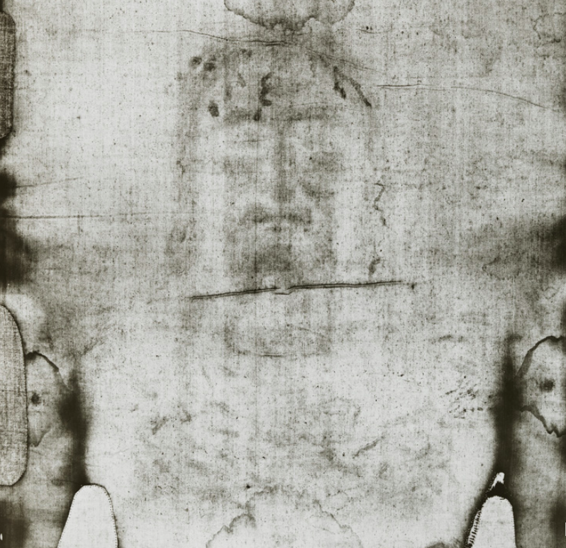
Vernon D. Miller, 1978
Notes:
https://shroudphotos.com

Slide 4
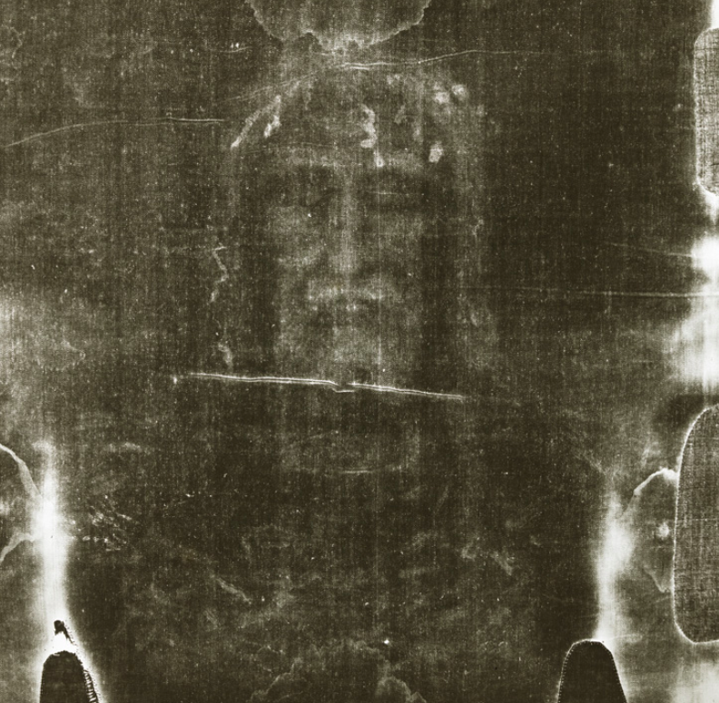
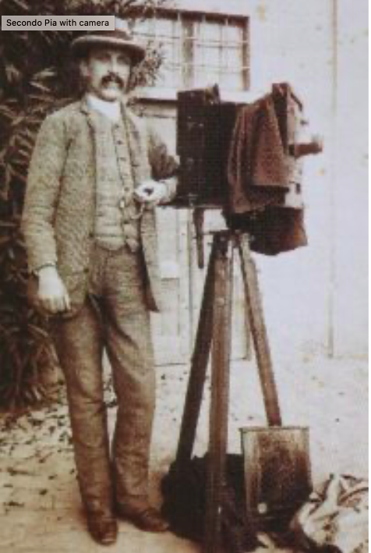
Secondo Pia, 1898

Slide 5
Isaiah, 52, 14
Just as there were many who were appalled at him —
his appearance was so disfigured beyond that of any human being
and his form marred beyond human likeness—

Slide 6
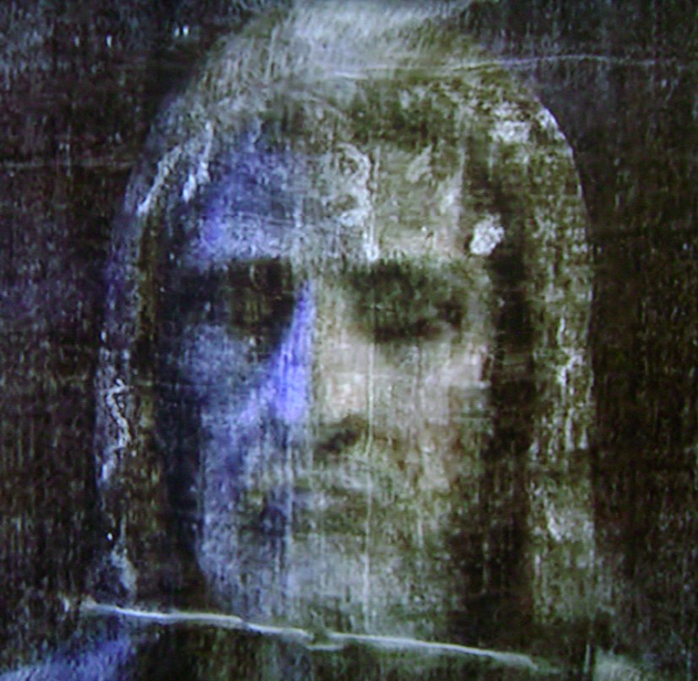
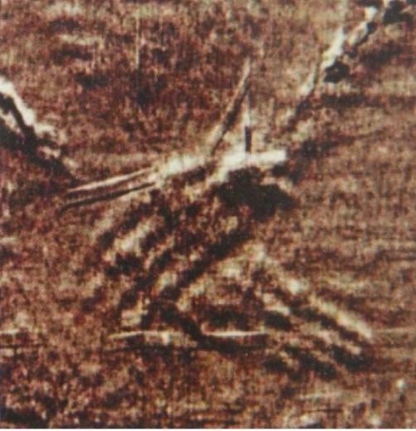
VP8 analyser, 1978, 3D data coded in the grey scale.
Notes:
https://shroud3d.com/introduction/3d-studies-of-the-shroud-of-turin-history/

Slide 7
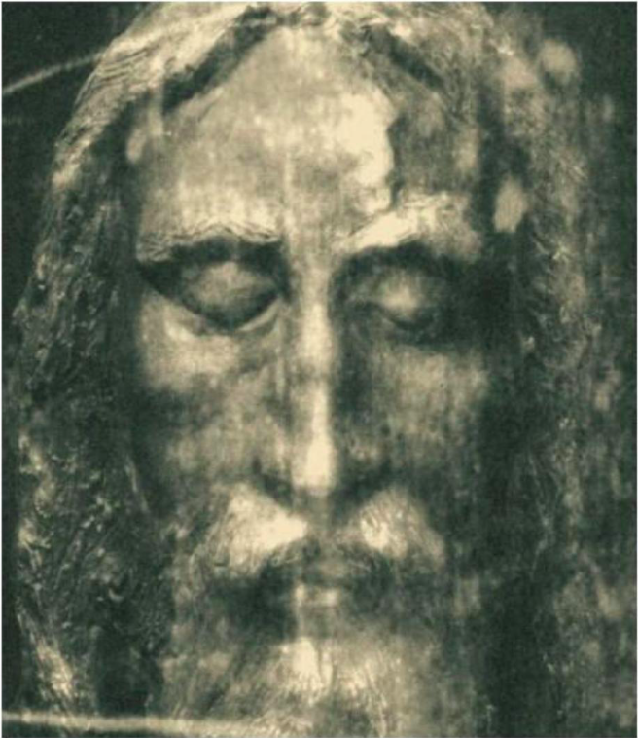

Slide 8
Matthew Ch. 27 v 59
Joseph took the body, wrapped it in a clean linen cloth, and placed it in his own new tomb that he had cut out of the rock.
Mark, 15 v 46 So Joseph bought some linen cloth, took down the body, wrapped it in the linen, and placed it in a tomb cut out of rock.

Slide 9
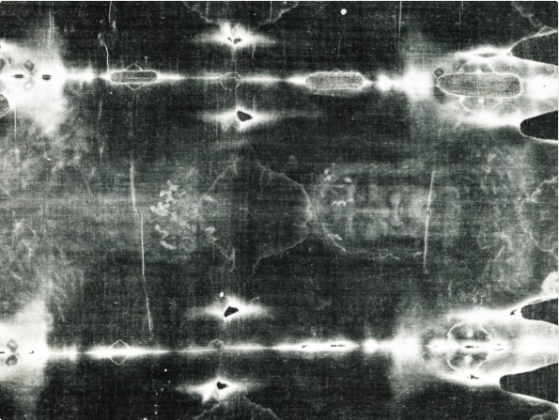

Slide 10
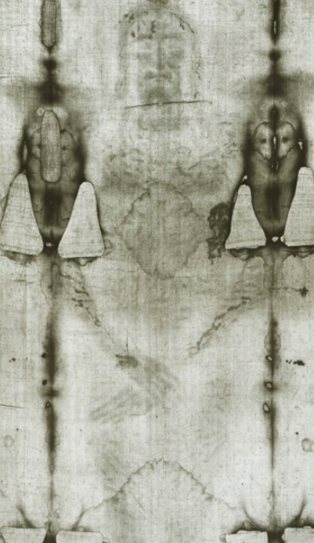
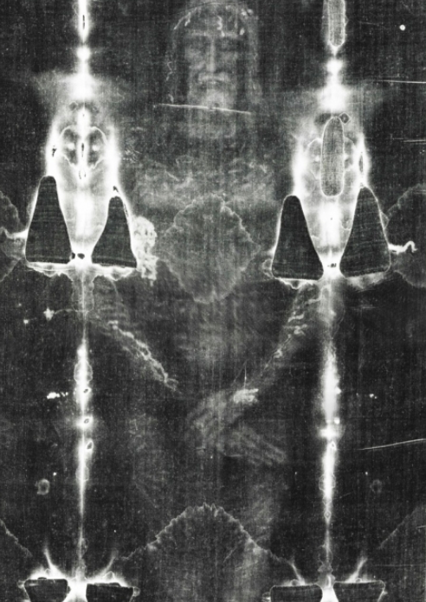

Slide 11
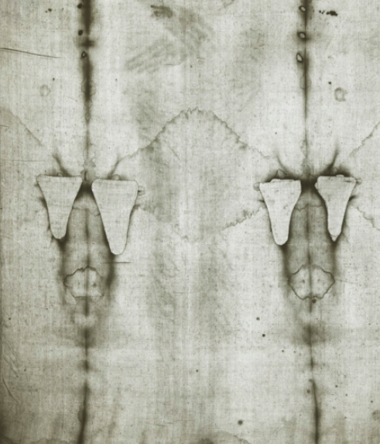
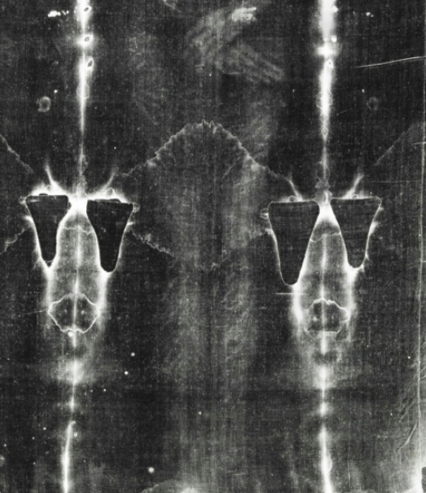

Slide 12
Luke 24 v 12
Peter, however, got up and ran to the tomb. Bending over, he saw the strips of linen lying by themselves, and he went away, wondering to himself what had happened.

Slide 13
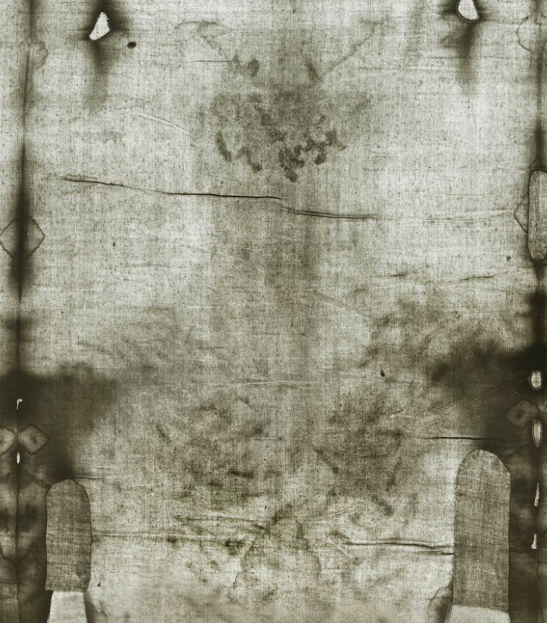
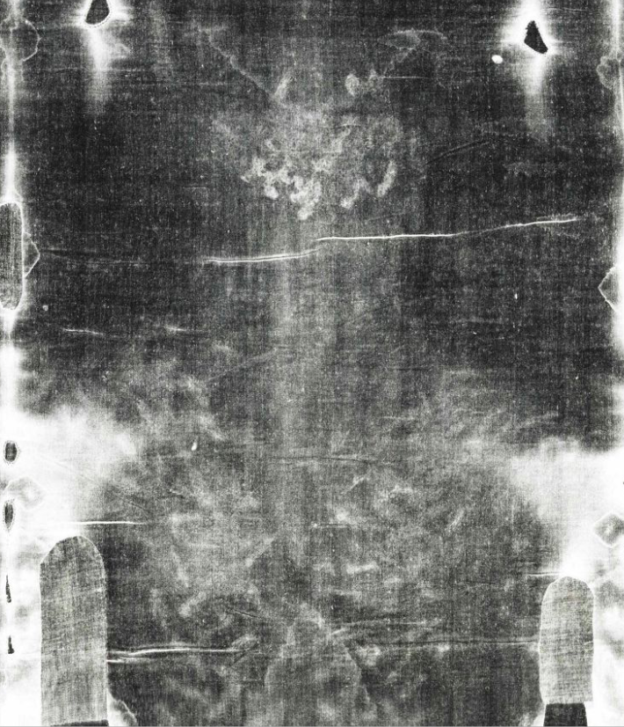

Slide 14
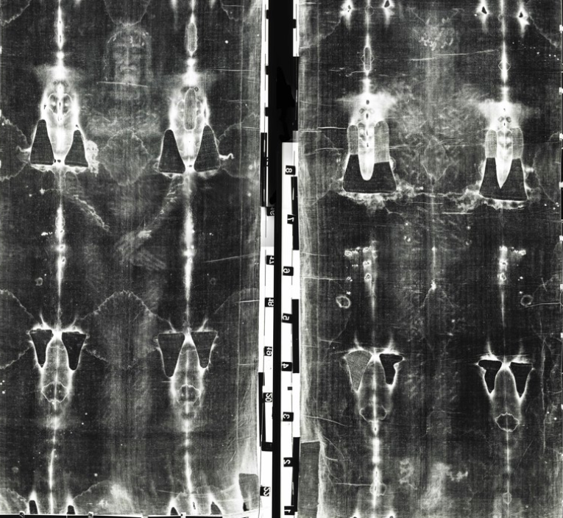
High contrast negative

Slide 15
From the image on the shroud
Nose broken
Swollen face, right eye bruised
Part of beard plucked out
Tearing wounds produced by the scourging
Wounds from the crown of thorns
Bruises on the shoulders due to carrying the weight of the cross
Knee injuries from repeated falls
Nail wounds from Roman crucifixion
Oval wound between the fifth and sixth ribs on the right side
Notes:
https://www.catholicnewsagency.com/news/252551/the-first-hyper-realistic-body-of-christ-based-on-the-holy-shroud-is-on-exhibit-in-spain

Slide 16
Nose broken, swollen face, right eye bruised
Matthew, 27, 30. They spit on him, and took the staff and struck him on the head again and again.
Mark, 14, 65. Then some began to spit at him; they blindfolded him, struck him with their fists, and said, “Prophesy!” And the guards took him and beat him.

Slide 17
Part of beard plucked out
Isaiah Ch. 50 v 6 I offered my back to those who beat me, my cheeks to those who pulled out my beard; I did not hide my face from mocking and spitting.

Slide 18
Tearing wounds produced by the scourging
Matthew, 27, 26, But he had Jesus flogged, and handed him over to be crucified.
John 19,1, Then Pilate took Jesus and had him flogged.

Slide 19
Wounds from the crown of thorns
Matthew, 27, 29, and then twisted together a crown of thorns and set it on his head.

Slide 20
Burse on the shoulders
John, 19,17. Carrying his own cross, he went out to the place of the Skull (which in Aramaic is called Golgotha).

Slide 21
Knee injuries from repeated falls
Cross carried by another.
Mark, 15,21. A certain man from Cyrene, Simon, the father of Alexander and Rufus, was passing by on his way in from the country, and they forced him to carry the cross.

Slide 22
Wound in the right side
John 19,33. but when they came to Jesus and found that he was already dead, they did not break his legs. ³⁴ Instead, one of the soldiers pierced Jesus’ side with a spear, bringing a sudden flow of blood and water.

Slide 23
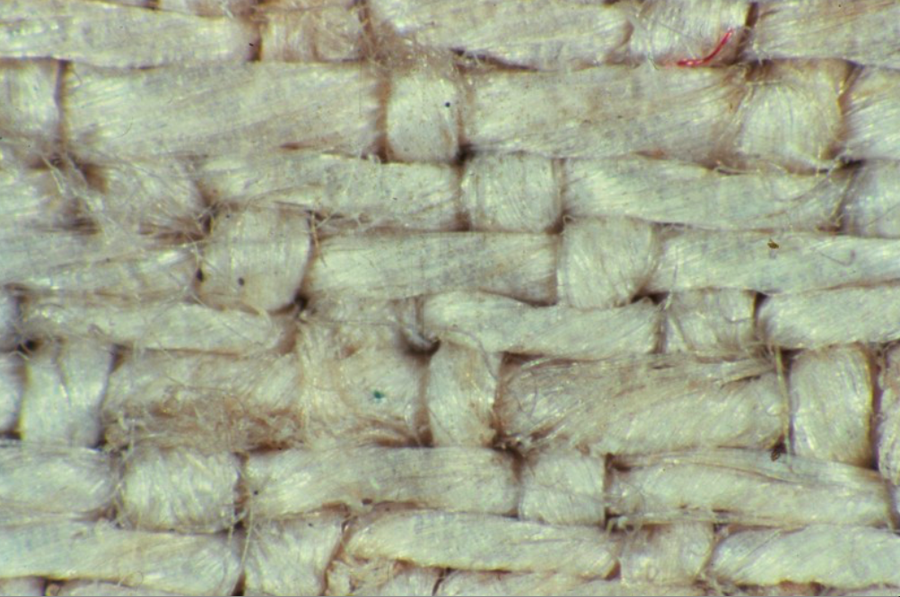
35mm colour transparency (32 x magnification)
Plain Shroud cloth where the is no blood or image.

Slide 24
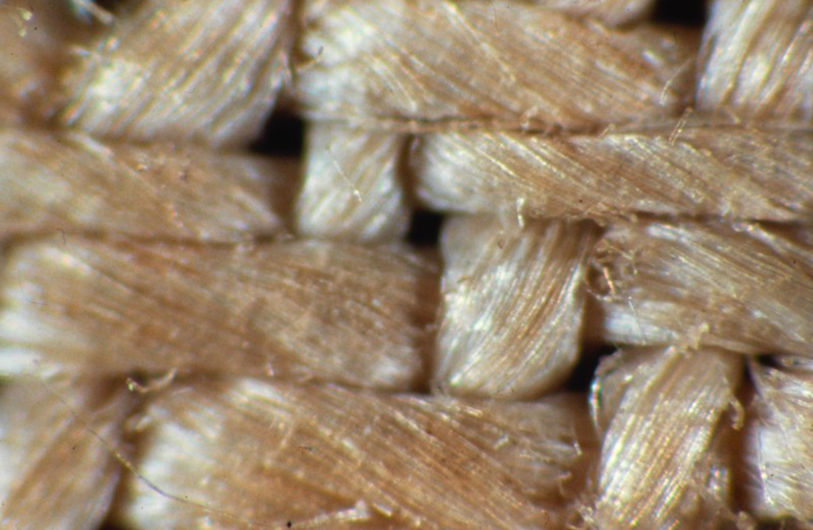
Nose of the image.
The yellowed fibers are the building blocks of the image.
The yellowed fibers run only one fiber deep. (microburn 200 - 500 nanometres)
If you follow one of these fibers until it dips below the next thread, the fiber then becomes white.
Notes:
https://www.shroud.com/pdfs/ssi3233part3.pdf

Slide 25
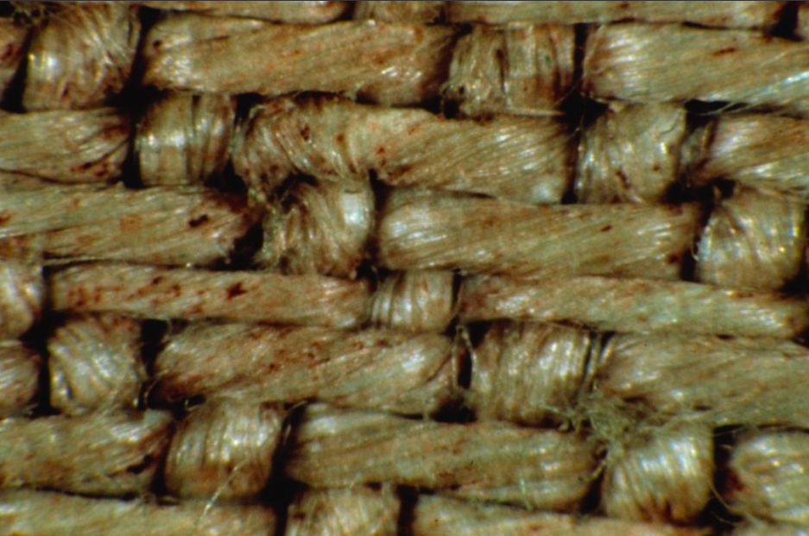
A blood area of the chest wound.
Yellowed from serum
Red-rust coloured blood
Haemoglobin and human albumin, S positive antigens

Slide 26
Spatial data eliminates photography and painting
Posture is of the deceased in rigor mortis
Notes:
https://www.shroud.com/78strp10.htm https://www.catholicnewsagency.com/news/252551/the-first-hyper-realistic-body-of-christ-based-on-the-holy-shroud-is-on-exhibit-in-spain

Slide 27
A Summary of STURP's Conclusions (1978)
No pigments, paints, dyes or stains have been found on the fibrils.
X-ray, fluorescence and microchemistry on the fibrils preclude the possibility of paint being used as a method for creating the image.
Ultra Violet and infrared evaluation confirm these studies.
Computer image enhancement and analysis by a device known as a VP-8 image analyser show that the image has unique, three-dimensional information encoded in it.
Microchemical evaluation has indicated no evidence of any spices, oils, or any biochemicals known to be produced by the body in life or in death.
Notes:
https://www.shroud.com/78conclu.htm

Slide 28
A Summary of STURP's Conclusions
It is clear that there has been a direct contact of the Shroud with a body
This type of contact might explain some of the features of the torso, it is totally incapable of explaining the image of the face with the high resolution that has been amply demonstrated by photography.
Experiments in physics and chemistry with old linen have failed to reproduce adequately the phenomenon presented by the Shroud of Turin.
There are no chemical or physical methods known which can account for the totality of the image, nor can any combination of physical, chemical, biological or medical circumstances explain the image adequately.
Thus, the answer to the question of how the image was produced or what produced the image remains, now, as it has in the past, a mystery.

Slide 29
A Summary of STURP's Conclusions (1978)
We can conclude for now that the Shroud image is that of a real human form of a scourged, crucified man.
It is not the product of an artist.
The blood stains are composed of haemoglobin and also give a positive test for serum albumin.
The image is an ongoing mystery … the problem remains unsolved.

Slide 30
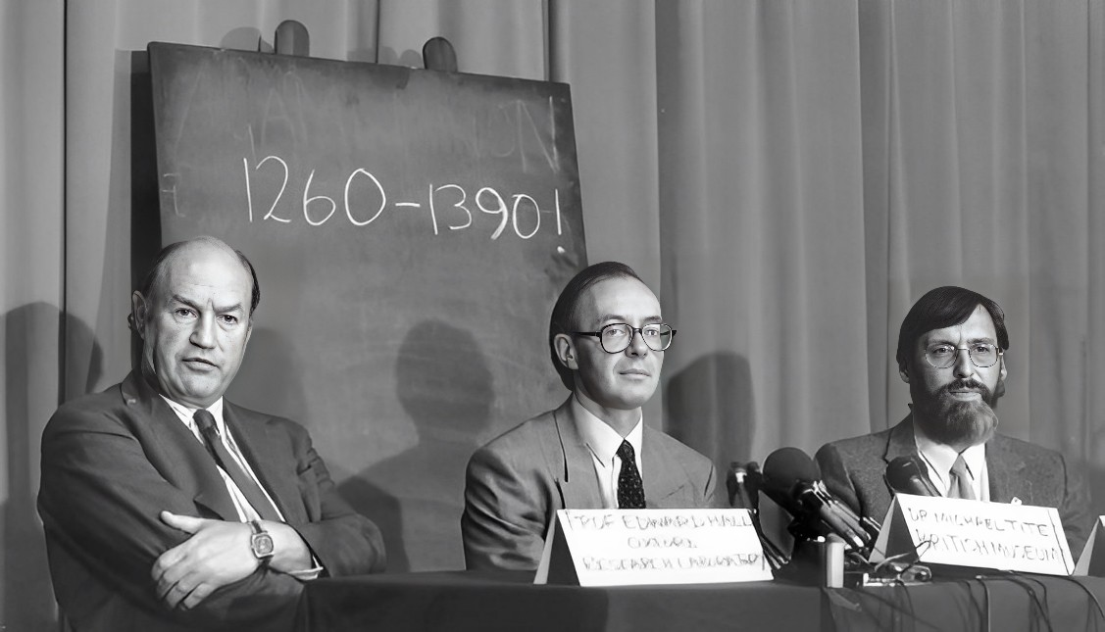
Top left corner sample
1988 study
Notes:
The result was a big surprise for many, and shocked the world. Their combined results dated the cloth to AD 1260-1390.

Slide 31
The radiocarbon sampling area is uniquely coated with a yellow–brown plant gum containing dye lakes. Pyrolysis-mass-spectrometry results from the sample area coupled with microscopic and microchemical observations prove that the radiocarbon sample was not part of the original cloth of the Shroud of Turin. The radiocarbon date was thus not valid for determining the true age of the shroud.
Fire, 1532
Notes:
https://www.sciencedirect.com/science/article/abs/pii/S0040603104004745

Slide 32
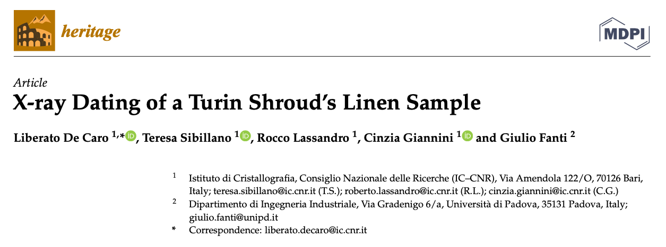
(Paper from 2022)
Inspecting fibre structural degradation by means of Wide-Angle X-ray Scattering
The experimental results are compatible with the hypothesis that the TS is a 2000-year-old relic
Notes:
https://www.mdpi.com/2571-9408/5/2/47

Slide 33
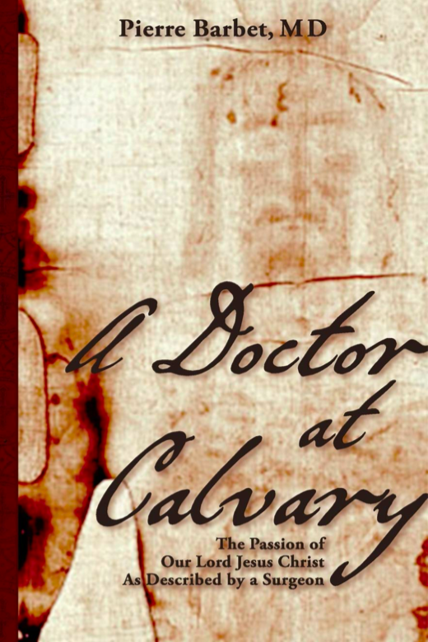
Pathology
Roman Flagrum, three thongs with twin balls of metal, two scorgers.
‘The markings on this image are so clear and medically accurate that the pathological facts which they reflect concerning the sufferings and death of the man depicted here are, in my opinion beyond dispute.’
Robert Bucklin, Forensic Pathologist
Notes:
https://www.amazon.com/Doctor-Calvary-Passion-Described-Surgeon/dp/1626548846
https://www.shroud.com/bucklin.htm

Slide 34
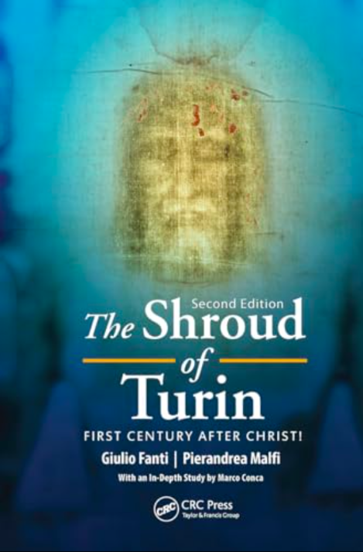
Jerusalem dirt
Found on soles of the feet, left knee and nose
Dirt of feel found under bloodstains
Limestone (calcium carbonate), crystals consistent local samples

Slide 35
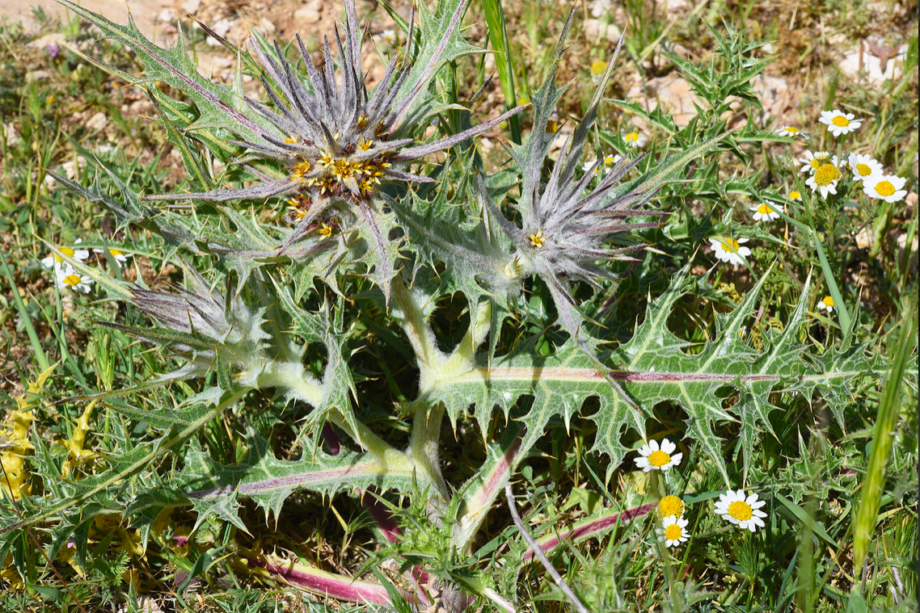
Pollen fingerprint
Jerusalem, North and South Turkey, France, Italy
Gundelia tournefortii
Flowers in Jerusalem area, February to May
Passover begins 15th day Nisan, (March 26 and April 25)
Notes:
https://powo.science.kew.org/taxon/urn:lsid:ipni.org:names:210758-1

Slide 36
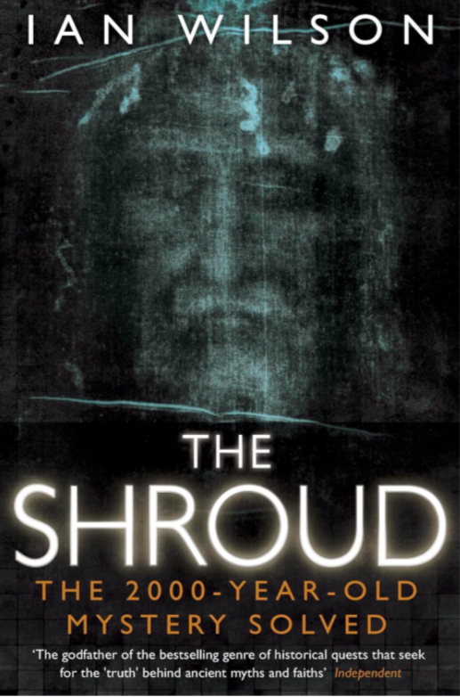
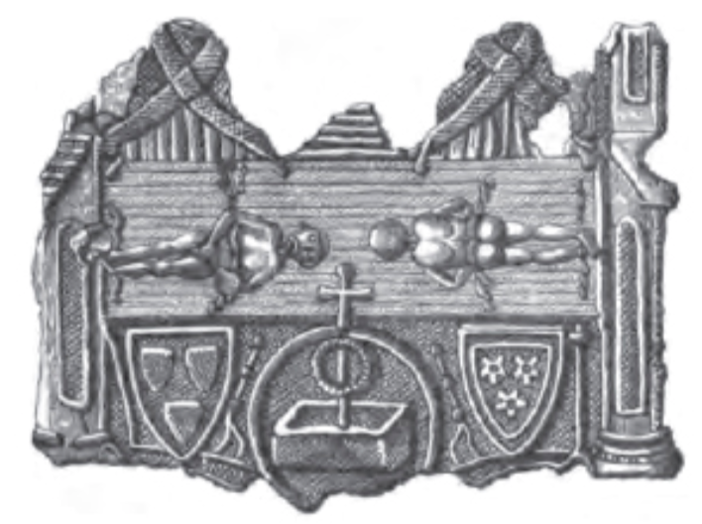
History
Sermon of Athanasius, 68, imago of our Lord and Savior at full length
Image of Edessa, 212
Image not made by human hands (Constantinople, 944)
1354, Lirey, France

Slide 37
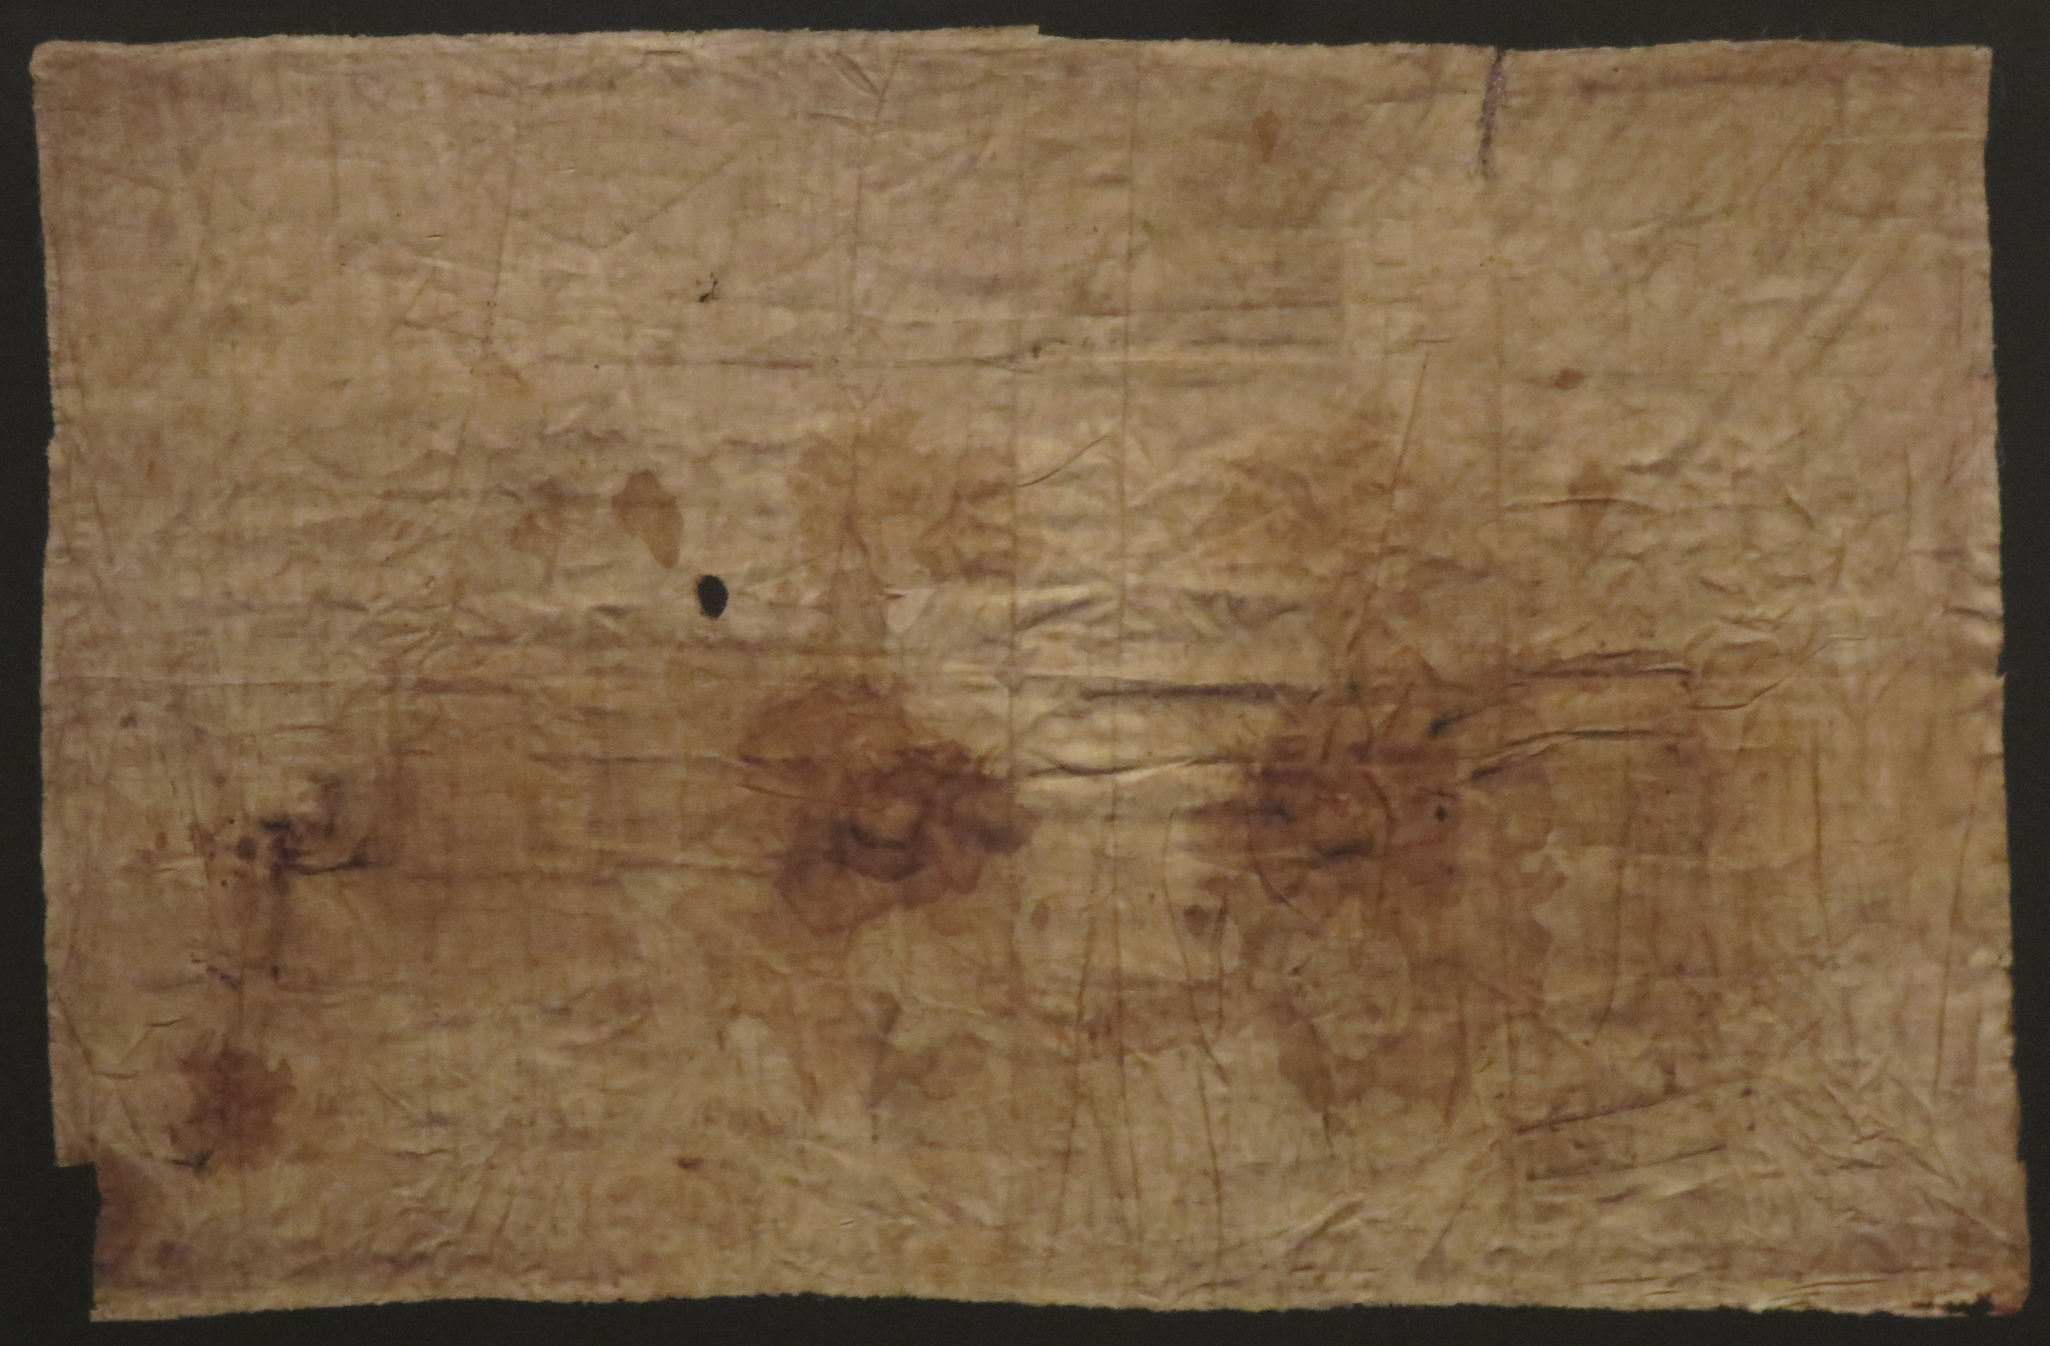
Sudarium of Oviedo, (616 AD)

Slide 38
John 20, 6-7
Then Simon Peter came along behind him and went straight into the tomb. He saw the strips of linen lying there, as well as the cloth that had been wrapped around Jesus’ head. The cloth was still lying in its place, separate from the linen.

Slide 39
Sudarium of Oviedo
Jerusalem dirt, ‘chemical signatures closely correlated with dirt samples from the Calvary site in Jerusalem’
Dirt on the nose area
120 blood stains coincide with the facial area of the shroud of Turin
Provenance, Ovedo cathedral, well documented history back to 1075
Notes:
https://www.routledge.com/The-Shroud-of-Turin-First-Century-after-Christ/Fanti-Malfi/p/book/9789814800082?utm_source=cjaffiliates&utm_medium=affiliates&cjevent=0769674092b111ef83fd9dcb0a18ba73
https://www.youtube.com/watch?v=mX-sjrtuhYU&t=1838s

